Slide 1
Report on 2017 Water Risk Cities
Presented by Yash

Slide 2

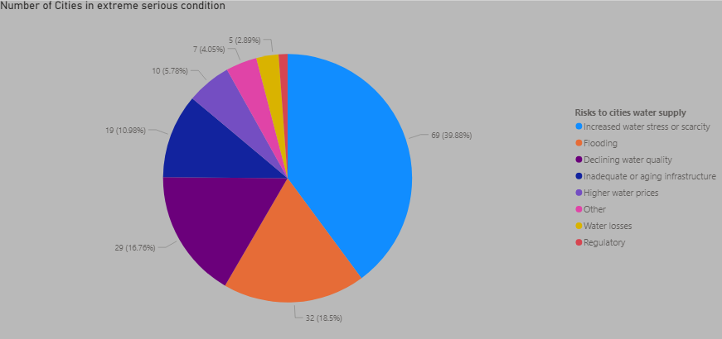
Observations/Insights
Out of the 195 countries & 10,000 cities in the world, we only have data of 69 countries and 308 cities which cover around 6.1% of the world population, and out of 96 C40 group cities we have data of only 62 of them.
In most of the cities, the extremely serious problems are water scarcity, flooding and decreasing water quality.

Slide 3
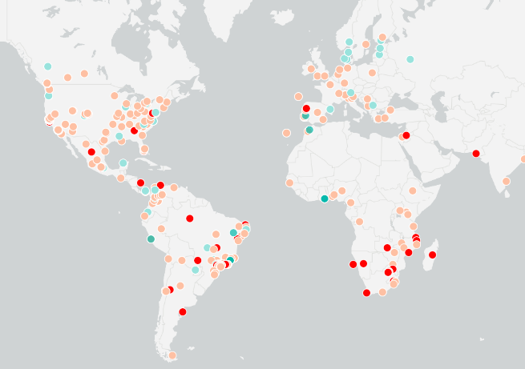
We can see that the cities with extreme serious conditions are majorly in Southern Africa and South America.

Slide 4
CHALLENGES FACED
Duplicate rows in the ‘population’ column
Knowledge on Data
Power BI & Excel

